Slide 1







Perth Machine Learning Group
@PerthMLGroup

Slide 2
Perth Machine Learning Group
www.fast.ai (Part 1, 2 & NLP)
forums.fast.ai
Part 1 course v4 to be released in July 2020

Slide 3

PMLG.org
www
GENERAL ADVICE WARNING
DISCLAIMER
All statements made by PMLG are made in good faith and we believe they are accurate and reliable. PMLG does not give any warranty as to the accuracy, reliability or completeness of information that is contained in its media, except in so far as any liability under statute cannot be excluded. PMLG, its directors, employees and their representatives do not accept any liability for any error or omission in any PMLG media, correspondence or events or for any resulting loss or damage suffered by the recipient or any other person. Unless otherwise specified, copyright of information provided on PMLG media are the property of PMLG.
The information provided on and through all PMLG media, correspondence and events is general in nature only and does not constitute personal advice. The information has been prepared without taking into account your personal objectives, situation or needs. Before acting on any information on this website you should consider the appropriateness of the information having regard to your objectives, situation and needs. Therefore, before you decide to act on any information, buy any product or keep or cancel a similar product that you already hold. Before making any decision, it is important for you to consider these matters and to seek appropriate technical, legal and other professional advice.

Slide 4






Thanks to our sponsors:
To win a 12-mth professional licence

Slide 5
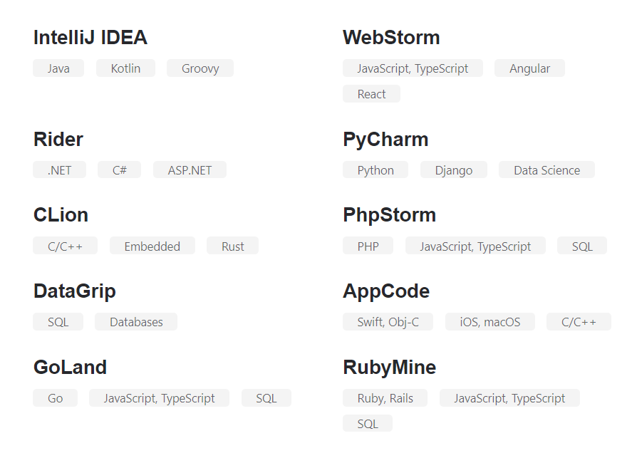
Lucky Draw for 3 x 12-mth professional licences
Condition: activate it within 30 days
To participate: raise your hand in Zoom
Result will be announced at the end of this event.

Slide 6
Rundown
www
5.30 pm Workshop starts
5.40 pm PMLG starts
7.00 pm break
7.15 pm PMLG continues
8.?? pm stand up feedback & lucky draw announcement
8.30 pm Workshop finishes
Learning objective:
- hands on development of image classification model

Slide 7
Let’s start
www
Log into your destinated Google account
Main GitHub: https://github.com/pmlg/SheCodes20
Alternative GitHub:

Slide 8
Next Steps
Join forum.fast.ai and go through fast.ai course
Join and follow Perth Machine Learning Group
@PerthMLGroup
Lucky Draw winners are ……
www

Slide 9
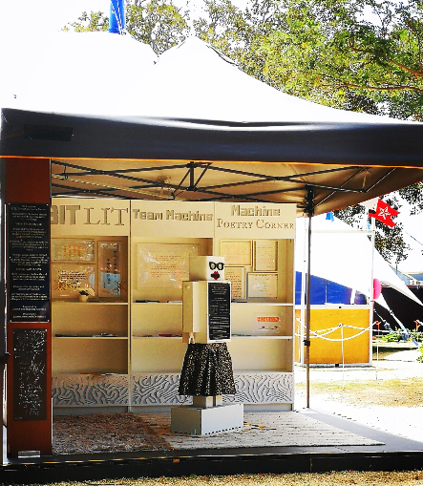
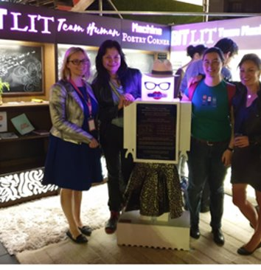
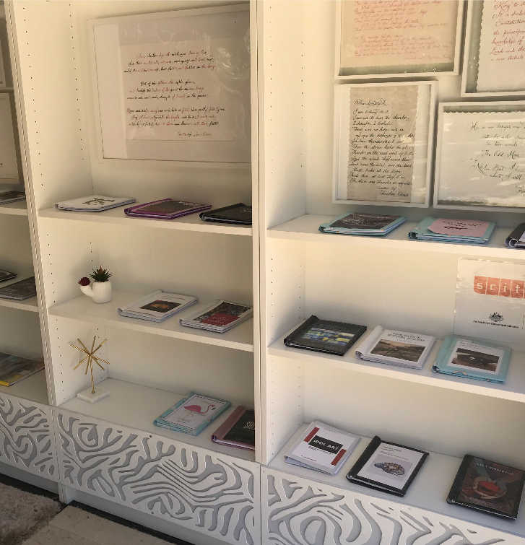
Fringe 2019: BitLit Machine Poetry Corner

Slide 10

